Slide 1

Topic: Recent advanced component mode synthesis and its applications for structural and multiphysics analysis
Korean Congress on Computational Mechanics 2019, Feb 15, 2019
Jin-Gyun Kim (Presenting autor), Changuk Ahn, Hee Sun Choi
Modeling & Simulation (M&S) laboratory,
Department of Mechanical Engineering Kyung Hee University

Slide 2
Contents
Introduction of component mode synthesis (CMS)
Structural problem: Family of Craig-Bampton methods
Multiphysics problem: CMS for vibro-acoustic problem
Future works

Slide 3
Introduction of component mode synthesis (CMS)

Slide 4
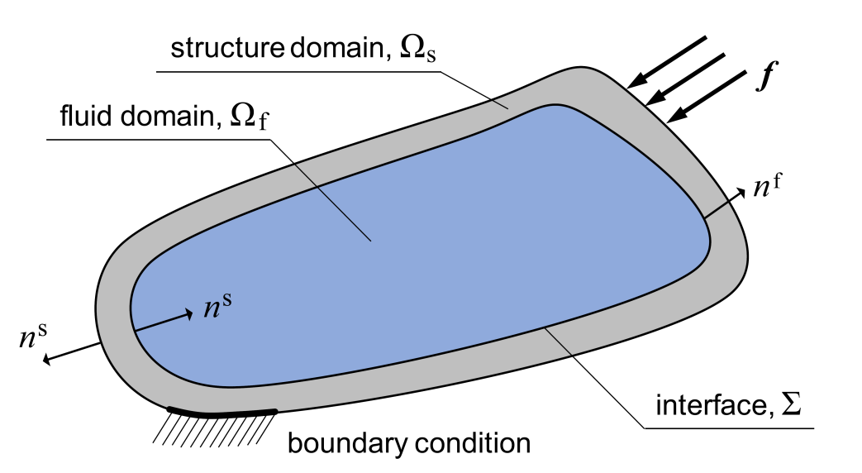
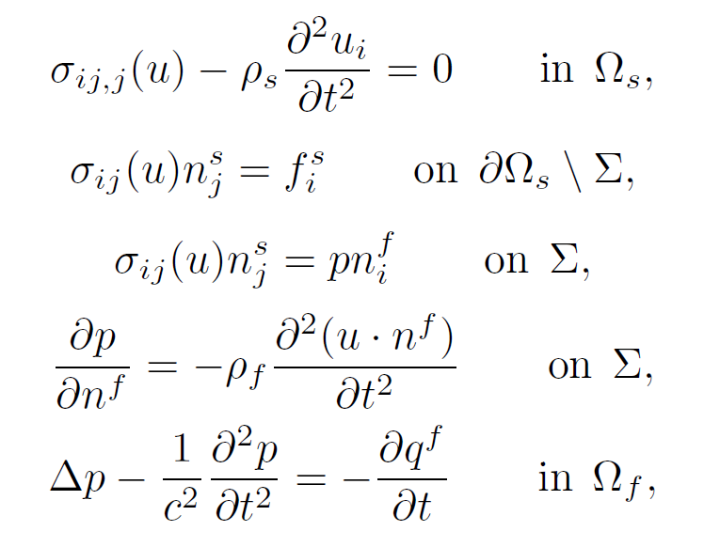
1.1 Multiphysics ROM
Variational formulations
Morand, Henri J-P., and Roger Ohayon. Fluid structure interaction. John Wiley, 1995.
- 4 -

Slide 5
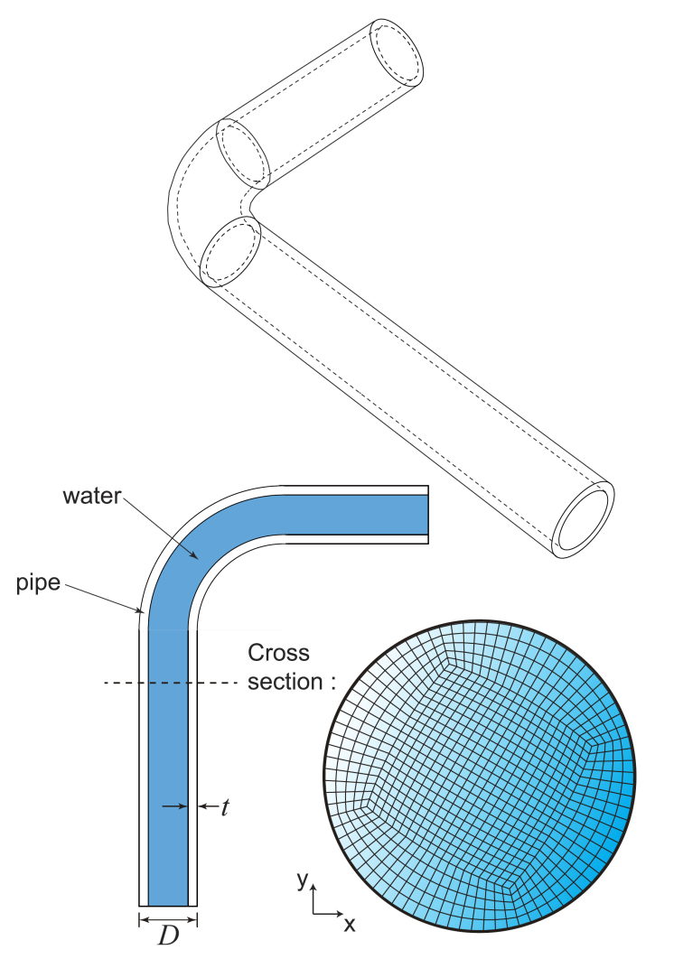
1.2 Multiphysics ROM
Full model
300 MPa
0 MPa
Weakly coupled
Strongly coupled
SM Kim, JG Kim*, SW Chae, KC Park, Strongly coupled model reduction of structural-acoustic interaction, Computer Methods in Applied Mechanics and Engineering, 347, 495-516, 15 April 2019 [as a corresponding author].
- 5 -

Slide 6
Thank you
https://sites.google.com/site/modelingnsimulation/

